Slide 1
Inequalities
REASONING ABILITY

Slide 2
Inequalities
Inequality is one of the most important topics from which 3-5 questions are expected in the bank exams. Inequalities questions are either asked directly or in the coded form & both of the types are important. Here in this session, we will discuss the basics of inequality:

Slide 3
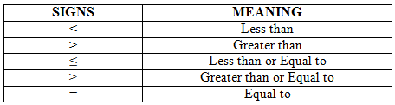
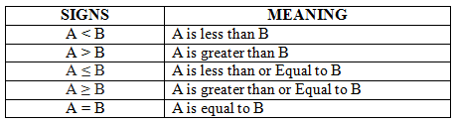
Inequalities
There are 5 types of inequality signs:
Let us consider two variables A and B, then inequalities can be shown as following:

Slide 4
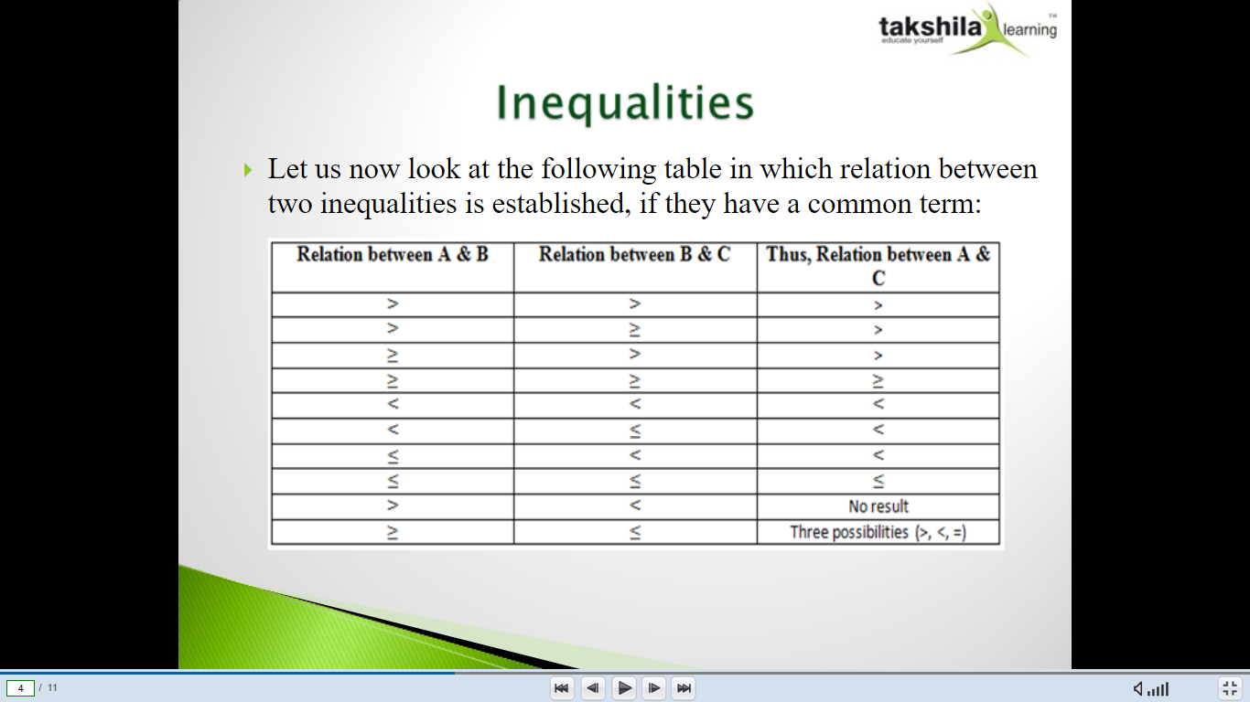

Slide 5
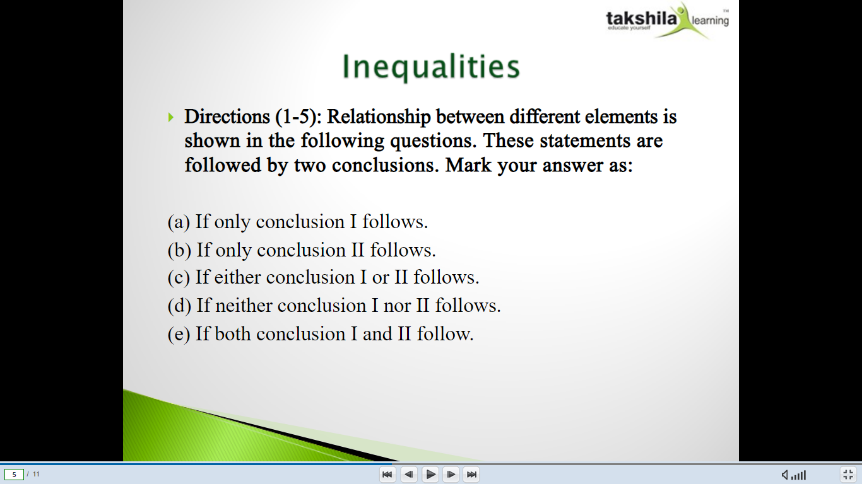

Slide 6
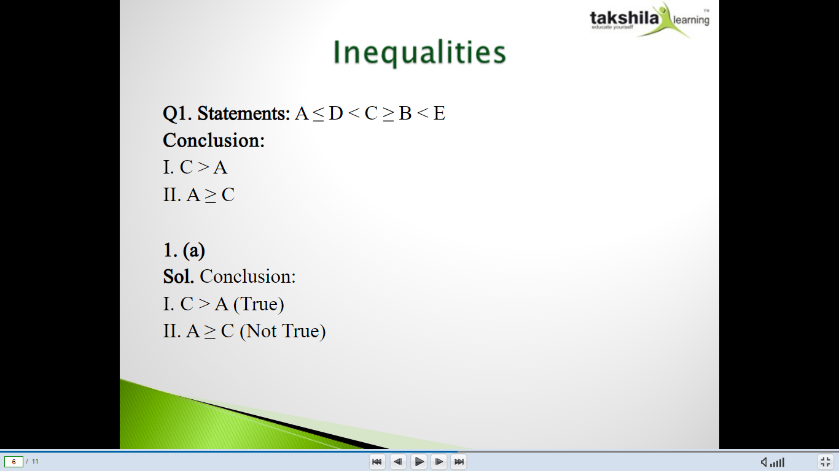
Notes:
A

Slide 7
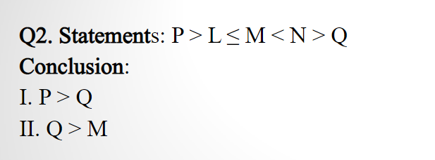
Notes:
D

Slide 8

Notes:
B

Slide 9

Notes:
D

Slide 10
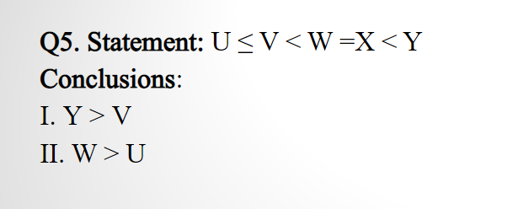
Notes:
E

Slide 11
Directions: The symbols @, #, % , $ and © are used in the following questions with the meaning as mentioned below.
‘P is not smaller than Q’ is represented by ‘P$Q’.
‘P is not greater than Q’ is represented by ‘P@Q’.
‘P is neither greater than nor equal than Q’ is represented by ‘P#Q’.
‘P is neither equal to nor smaller than Q’ is represented by ‘P©Q’.
‘P is neither smaller than nor greater than Q’ is represented by ‘P%Q’.

Slide 12
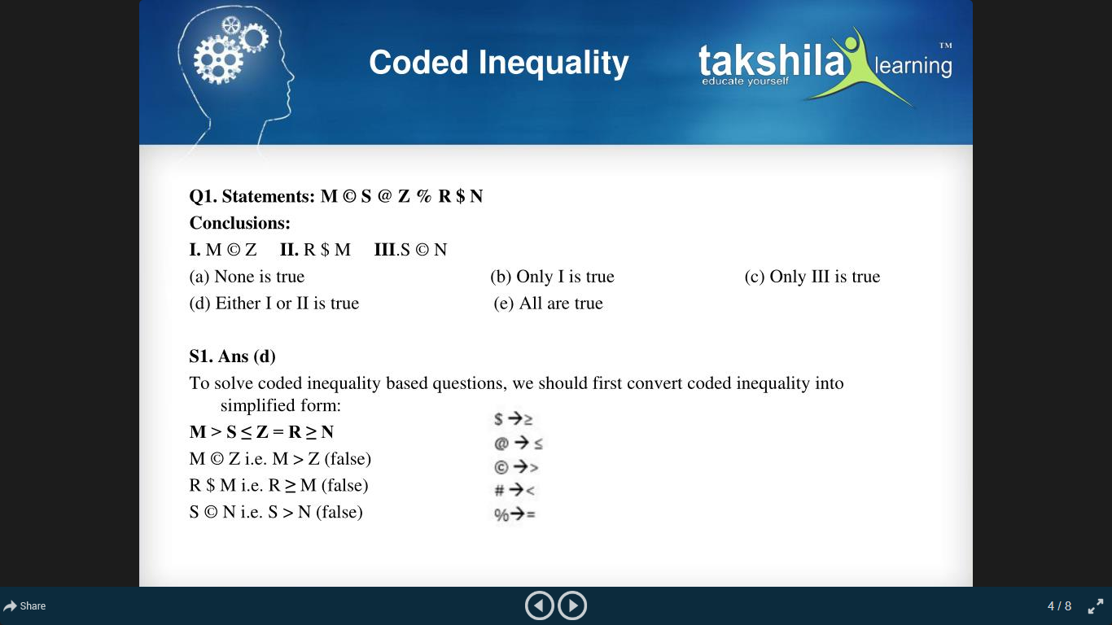
v
Notes:
D

Slide 13
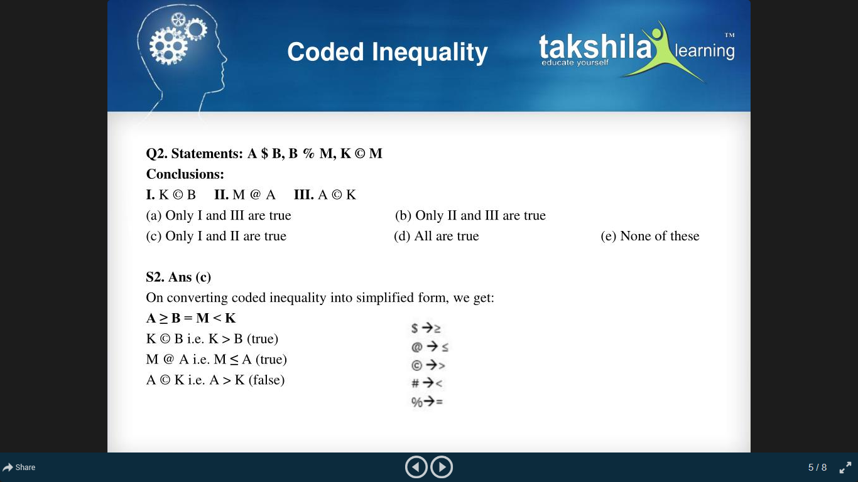
Notes:
C

Slide 14
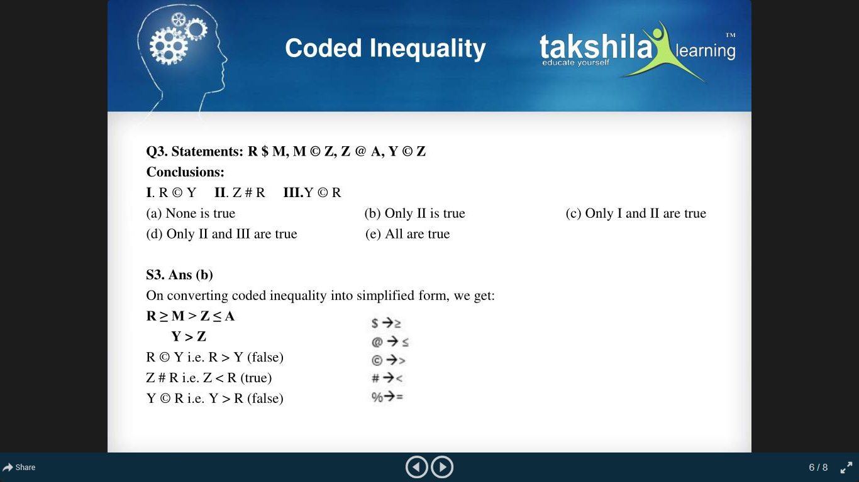
Notes:
B

Slide 15
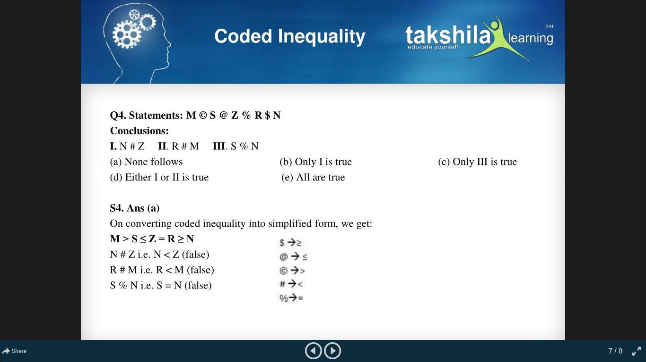
Notes:
A

Slide 16
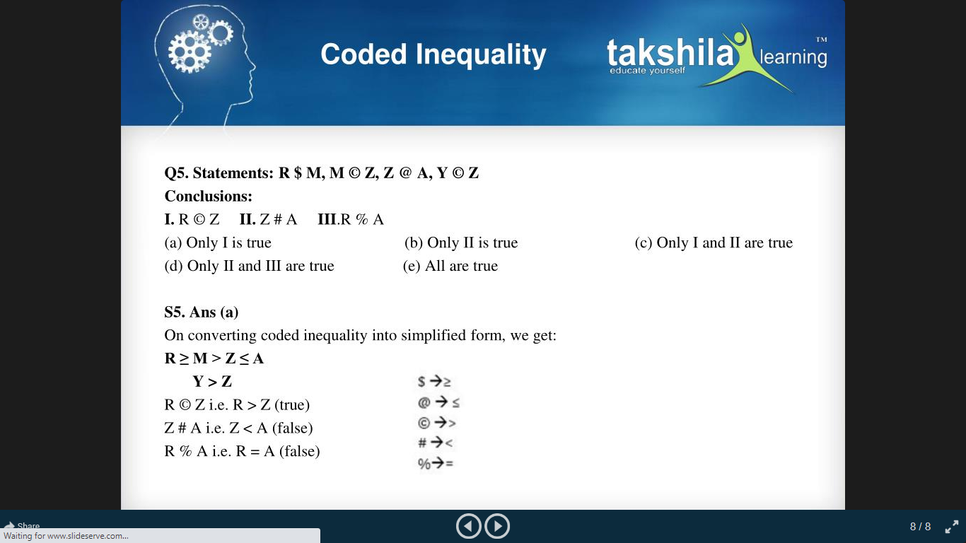
Notes:
A

Slide 17
Directions: Read the following information carefully and answer the questions given beside
A@B means A is not greater than B.
A!B means A is greater than B
A*B means A is not less than B.
A%B means A is less than B.
A#B means A is neither greater than nor less than B

Slide 18
Options: a) Only conclusion I follows b) Only conclusion II follows c) Either conclusion I or conclusion II follows d) Both conclusion I and II follow e) Neither conclusion I nor conclusion II follows
11. Statements : M!H , K%M, G#H
Conclusions : H#K , M!G

Slide 19
12. Statements : E@F , D%E , T*F
Conclusions : D%F , T*E
13. Statements: T#Y , Y%L, G*L
Conclusions: L!T , G*T
14. Statements : G!U , L@U, M*G
Conclusions : M#U , M!U

Slide 20
15. Statements : Z!U , P*W , W@U
Conclusions : Z!W , P%U

Slide 21


